Slide 1
ACAMP Automated Care and Monitoring of Plants
Justin Johnson
Stark Pister
Wayland He
Danny Gunny

Slide 2
What is ACAMP?
ACAMP is a self-contained, sustainable system capable of growing any plants effectively
Lighting, Temperature/Humidity, Nutrients, and pH level all automated
Settings can be changed using Web UI so any type of plant can be grown
Environment can be monitored on website using a laser scanning system. Data will be saved so entire growth cycle can be observed

Slide 3
Why ACAMP?
Arable land and fresh water are decreasing, requiring a change in plant and food production
ACAMP will allow anyone to become a local food producer from the confines of their home
Allows for research into the effects of global warming on plant life
Sustainable hydroponic system reduces water consumption

Slide 4
Project Highlights
Automated environment adjustment
- your plants wont die when you go on vacation
Laser scanning system – get visualizations of growth environment
Web Monitoring and Control Dashboard
- change settings and view your plants progress online

Slide 5
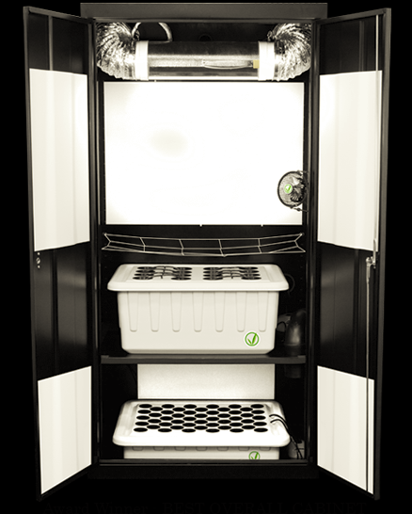
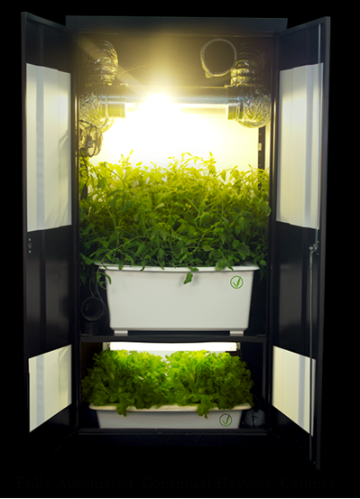
http://www.hydroponics.com/hydroshops/images/deluxe_lg.jpeg

Slide 6
Minimum Specifications
Monitor humidity, temperature, pH level, nutrient supply, and lighting using sensors read by microcontroller
Adjust environment to ensure each of these parameters are at their desired value
Determine plant height using a laser scanning system
Adjust height of light automatically to remain proportional to plant height

Slide 7
Minimum Specifications
Develop web interface to monitor and change the environment parameters
Make the system Internet-capable via Ethernet
System will guarantee at least one week of no human interaction

Slide 8
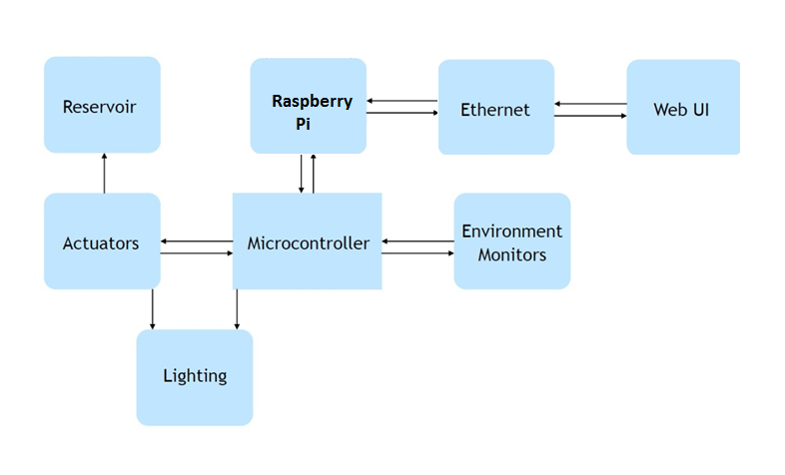
System Block Diagram

Slide 9
Division of Labor
Justin – Physical/Mechanical, Web design
Danny – Power supervision, Temperature/Humidity sensor
Stark - TDS sensor, Pump control system
Wayland – µController/Raspberry Pi integration, pH Sensor

Slide 10
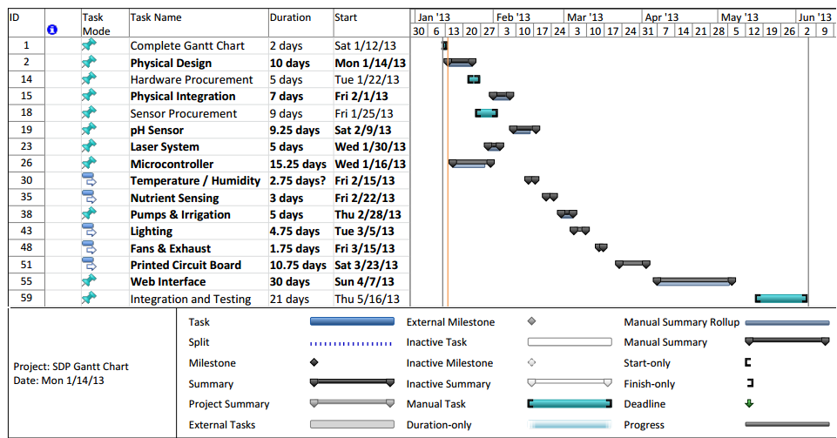
Gantt Chart

Slide 11
Preliminary Budget
 | Part | Qty | Price Per Unit | Total
Controller
 | Micro-controller | 2 | 30 | 60
 | Dev Board | 2 | 70 | 140
 | PCB Runs | 2 | 150 | 300
 | Web Hosting | 1 | 50 | 50
Casing
 | Enclosure | 1 | 100 | 100
 | Threaded Rods | 6 | 5 | 30
 | Ducting | 1 | 20 | 20
 | Tubing/Plumbing | 1 | 20 | 20
 | Plant Tray | 1 | 50 | 50
 | Reservoirs | 3 | 20 | 60
 | Discrete Electronics | 1 | 50 | 50
 | Assorted Structural Pieces | 1 | 50 | 50
Sensor Systems
Plant Height Sensor | Laser Diodes | 2 | 5 | 10
 | Receivers | 2 | 5 | 10
Plant Height Actuator | Stepper Motor | 2 | 5 | 10
 | Controller | 2 | 3 | 6
Temp/Humid Sensor | Temp/Humidity Sensor | 1 | 15 | 15
Temp/Humid Actuator | Heating Element | 1 | 10 | 10
 | Fans | 3 | 15 | 45
 | Humidifier | 1 | 50 | 50
 | Dehumidifier | 1 | 70 | 70
pH Sensor | pH Sensor | 1 | 100 | 100
pH Actuator | Servo Motor | 2 | 7 | 14
 | pH Solution | 1 | 20 | 20
TDS Sensor | TDS Sensor | 1 | 50 | 50
TDS Actuator | Servo Motor | 2 | 7 | 14
 | Nutrients | 1 | 40 | 40
Light Sensor | Photosensor | 1 | 5 | 5
Light Actuator | Light Enclosure | 1 | 10 | 10
 | Light Bulb | 2 | 40 | 80
 | Reflective Coating | 1 | 20 | 20
 | Servo Motor | 2 | 20 | 40
 |  |  | Total Price - | 1549

Slide 12
Summary of Progress
Discussion with Elkaim --- Raspberry Pi recommended for Ethernet capabilities
Visited Santa Cruz Hydroponics
Applied for Cowell and College 8 funding
Lab Space: Acquired
Greater game plan

Slide 13
Conclusions
Software/Admin privileges needed for lab
Lacking a sponsor / mentor
More funding desired
Excited to begin development

